Slide 1
Lexicon Mining for Semiotic Squares: Exploding Binary Classification
Jason S. Kessler*
Data Day Texas
January 27, 2018
http://bit.ly/LexiconMining
*No, not that Jason Kessler.
@jasonkessler

Slide 2
By the end of the talk
You’ll know how to programmatically create semiotic squares like this one.
Source: http://www.squadrati.com/2014/03/31/quadrato-semiotico-dei-wine-lovers/
http://bit.ly/LexiconMining
@jasonkessler

Slide 3
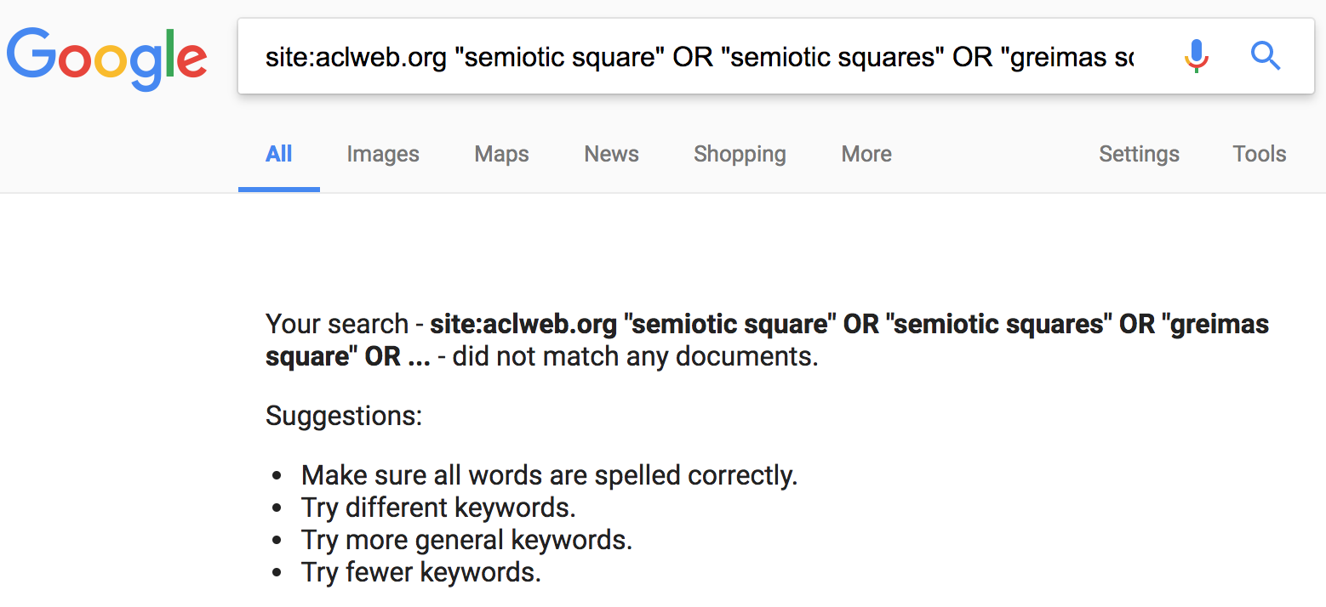
http://bit.ly/LexiconMining
@jasonkessler

Slide 4
Lexicon Mining for Semiotic Squares: Exploding Binary Classification
http://bit.ly/LexiconMining
@jasonkessler

Slide 5
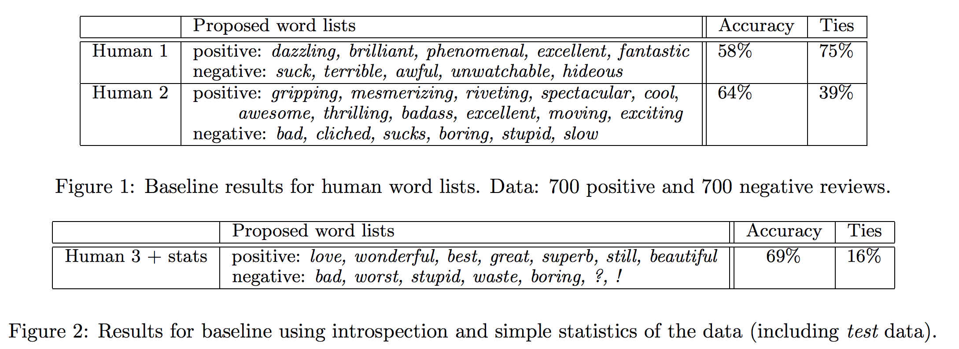
Lexicon speculation
http://bit.ly/LexiconMining
Bo Pang, Lillian Lee and Shivakumar Vaithyanathan. Thumbs up? Sentiment classification using machine learning techniques. EMNLP. 2002.
@jasonkessler

Slide 6
Lexicon mining ≠ lexicon speculation
http://bit.ly/LexiconMining
Bo Pang, Lillian Lee and Shivakumar Vaithyanathan. Thumbs up? Sentiment classification using machine learning techniques. EMNLP. 2002.
@jasonkessler

Slide 7
Lexicon mining
Let’s do a deep dive into lexicon mining
We’ll walk through the notebook linked below:
http://bit.ly/LexiconMining
@jasonkessler

Slide 8
Visualizing Category-Associated Lexicons using Scatterplots
@jasonkessler

Slide 9
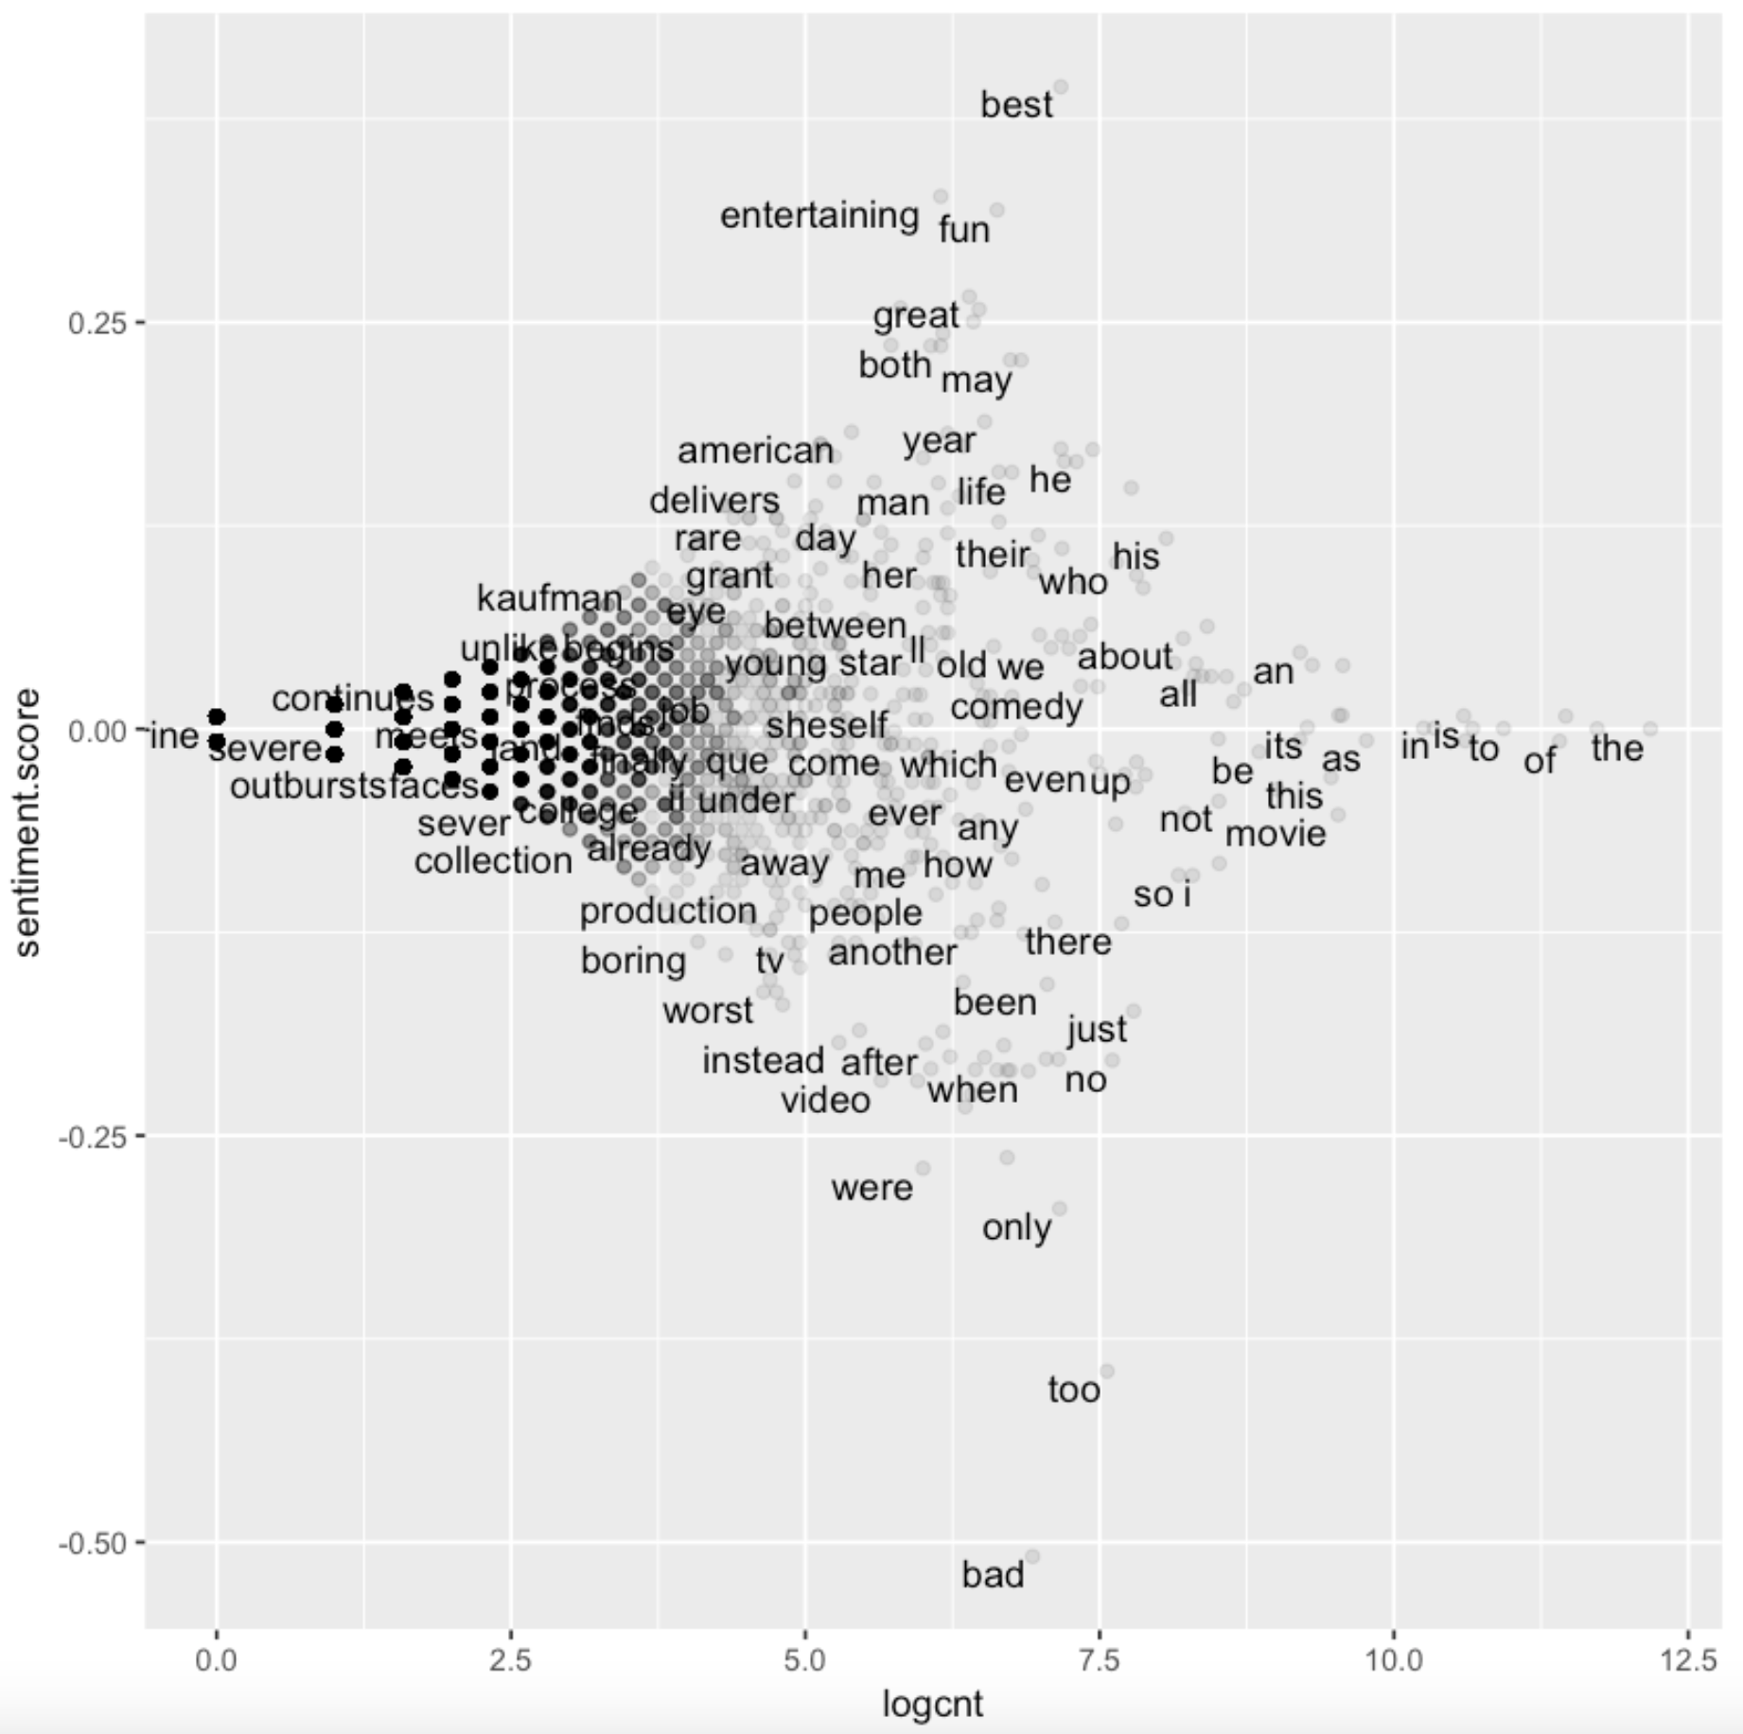
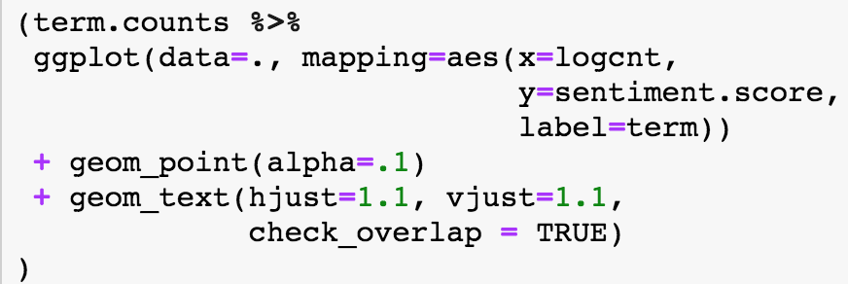
R: ggplot2
Most labels are legible
Labels can overlap points
Dense areas can be tough to read
Not recommended.
Use Scattertext instead, if possible.
@jasonkessler

Slide 10
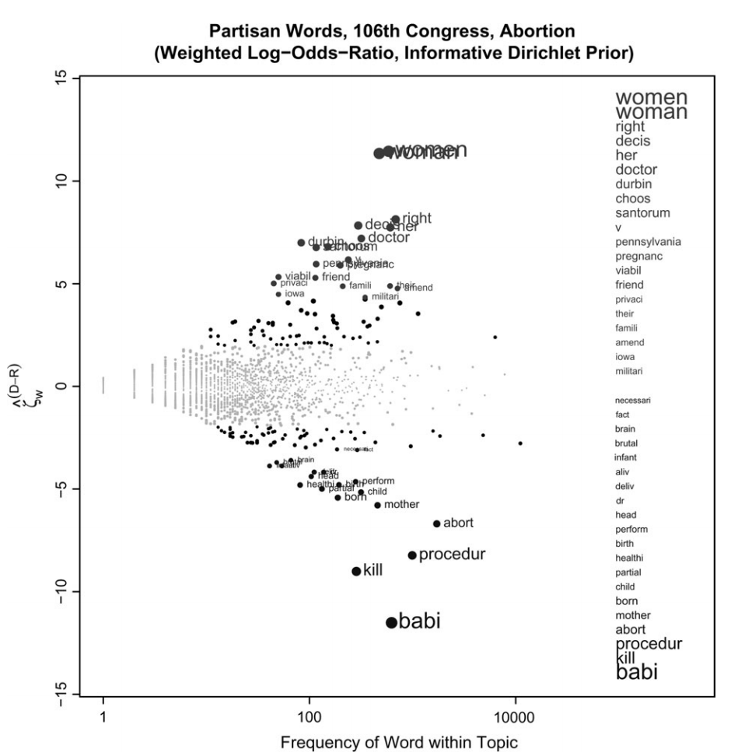
Monroe et. al plot
Identifies terms with z-scores > 1.96
Labels still overlap, only labels a few points
Burt Monroe, Michael Colaresi and Kevin Quinn. Fightin' words: Lexical feature selection and evaluation for identifying the content of political conflict. Political Analysis. 2008.
@jasonkessler

Slide 11
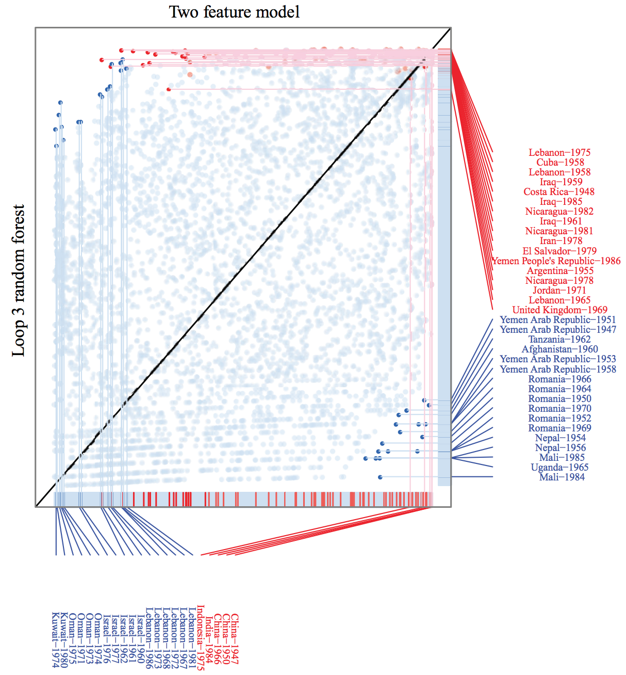
R package available:
https://github.com/zsmahmood89/ModelCriticism
Michael Colaresi and Zuhaib Mahmood. Do the robot: Lessons from machine learning to improve conflict forecasting. Journal of Peace Research. 2017.
@jasonkessler

Slide 12
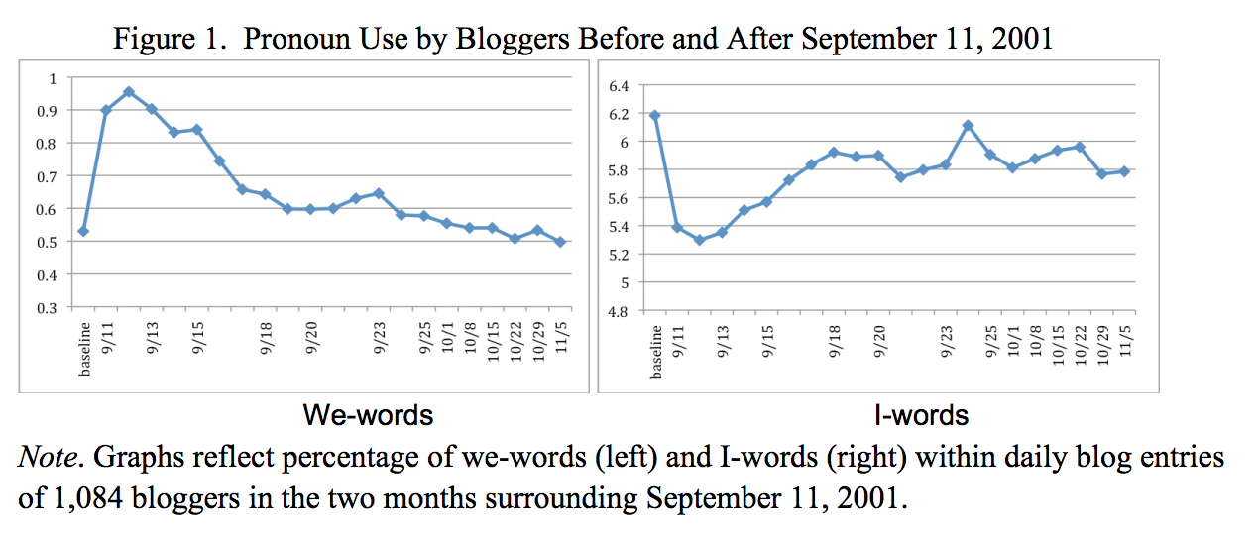
In defense of stop words
In times of shared crisis, “we” use increases, while “I” use decreases.
I/we: age, social integration
I: lying, social position relative hearer, testosterone
Cindy K. Chung and James W. Pennebaker. Counting Little Words in Big Data: The Psychology of Communities, Culture, and History. EASP. 2012
@jasonkessler

Slide 13
Stop words in context: gender
Performed on a variety of language categories, including speech.
Other studies have found that function words are the best predictors of gender.
LIWC Dimension Bold: entirely stopwords | Effect Size (Cohen’s d) (>0 F, <0 M) MANOVA p<.001
All Pronouns | 0.36
Present tense verbs (walk, is, be) | 0.18
Feeling (touch, hold, feel) | 0.17
Certaintyns (always, never) | 0.14
Word count | NS
Numbers | -0.15
Prepositions | -0.17
Words >6 letters | -0.24
Swear words | -0.22
Articles | -0.24
Newman, ML; Groom, CJ; Handelman LD, Pennebaker, JW. Gender Differences in Language Use: An Analysis of 14,000 Text Samples. 2008
@jasonkessler

Slide 14
Lexicon Mining for Semiotic Squares: Exploding Binary Classification
@jasonkessler

Slide 15
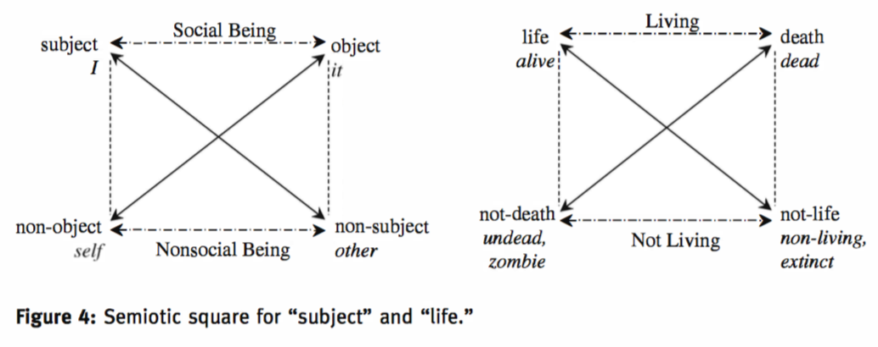
Pelkey, Jamin. 2017. Greimas embodied: How kinesthetic opposition grounds the semiotic square. Semiotica 214(1). 277–305
Original Semiotic Square paper:
Greimas, A.J. and Francis Rastier. 1968. “The Interaction of Semiotic Constraints,” Yale French Studies. 41: 86-105.
@jasonkessler

Slide 16
Language about movies
The domain of discourse
From where we draw concepts to create the semiotic square
@jasonkessler

Slide 17
Language about movies
Positive
Negative
Positive sentiment
Positive sentiment
Opposition relation
These are treated as contrastive concepts
@jasonkessler

Slide 18
Language about movies
Positive
Negative
Positive sentiment
Positive sentiment
Entailment relation
¬Negative includes positive sentiment
¬Negative
Language that’s not negative
@jasonkessler

Slide 19
Language about movies
Positive
Negative
Positive sentiment
Positive sentiment
Contradiction relation
Negative and ¬Negative are mutually exclusive*
¬Negative
Language that’s not negative
*exceptions, e.g., damning with faint praise”
@jasonkessler

Slide 20
Language about movies
Positive
Negative
Positive sentiment
Positive sentiment
Complete the square
¬Negative
¬Positive
Language that’s not negative
Language that’s not positive
@jasonkessler

Slide 21
Language about movies
Positive
Negative
Positive sentiment
Positive sentiment
¬Negative
¬Positive
Language that’s not negative
Language that’s not positive
Objective
Plot descriptions
Neutral term
@jasonkessler

Slide 22
Language about movies
Evaluative
Complex term
Reviews
Positive
Negative
Positive sentiment
Positive sentiment
¬Negative
¬Positive
Language that’s not negative
Language that’s not positive
Objective
Plot descriptions
@jasonkessler

Slide 23
Language about movies
Evaluative
Reviews
Positive
Negative
Positive sentiment
Positive sentiment
Aspects of well-reviewed movies
Positive deixis
¬Negative
¬Positive
Language that’s not negative
Language that’s not positive
Objective
Plot descriptions
@jasonkessler

Slide 24
Language about movies
Evaluative
Reviews
Positive
Negative
Positive sentiment
Positive sentiment
Aspects of well-reviewed movies
Aspects of poorly-reviewed movies
¬Negative
¬Positive
Negative deixis
Language that’s not negative
Language that’s not positive
Objective
Plot descriptions
@jasonkessler

Slide 25
Language about movies
Semiotic square
Evaluative
Reviews
Positive
Negative
Positive sentiment
Positive sentiment
Aspects of well-reviewed movies
Aspects of poorly-reviewed movies
¬Negative
¬Positive
Language that’s not negative
Language that’s not positive
Objective
Plot descriptions
@jasonkessler

Slide 26
Lexicalizing the Semiotic Square
Task:
Find language associated with each element of the square
Domain of discourse
Corpus of documents pertaining to domain (e.g., movie-related text)
Corpus is divided into three categories
Domain of discourse
Complex Term
Pos
Neg
Positive Deixis
Negative Deixis
¬Neg
¬Pos
Neutral Term
@jasonkessler

Slide 27
Lexicalizing the Semiotic Square: Copora
Positive Documents
Negative Documents
Complex term
Pos
Neg
E.g., negative reviews
E.g., positive reviews
Positive Deixis
Negative Deixis
¬Neg
¬Pos
Neutral Term
Neutral Documents
Plot descriptions
@jasonkessler

Slide 28
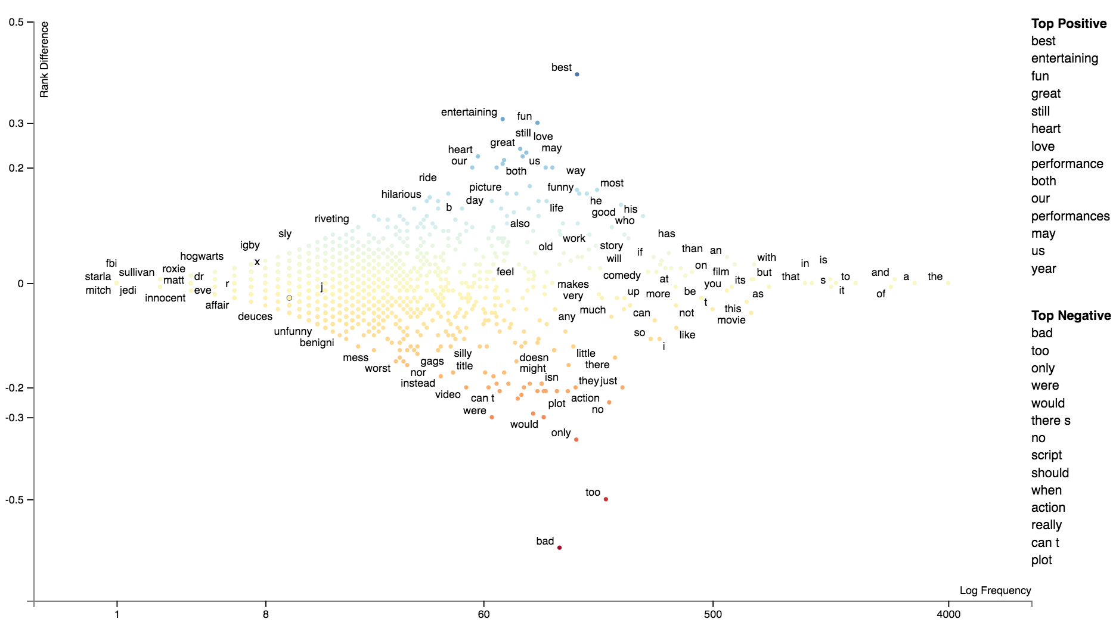
POSITIVE
NEGATIVE
@jasonkessler

Slide 29
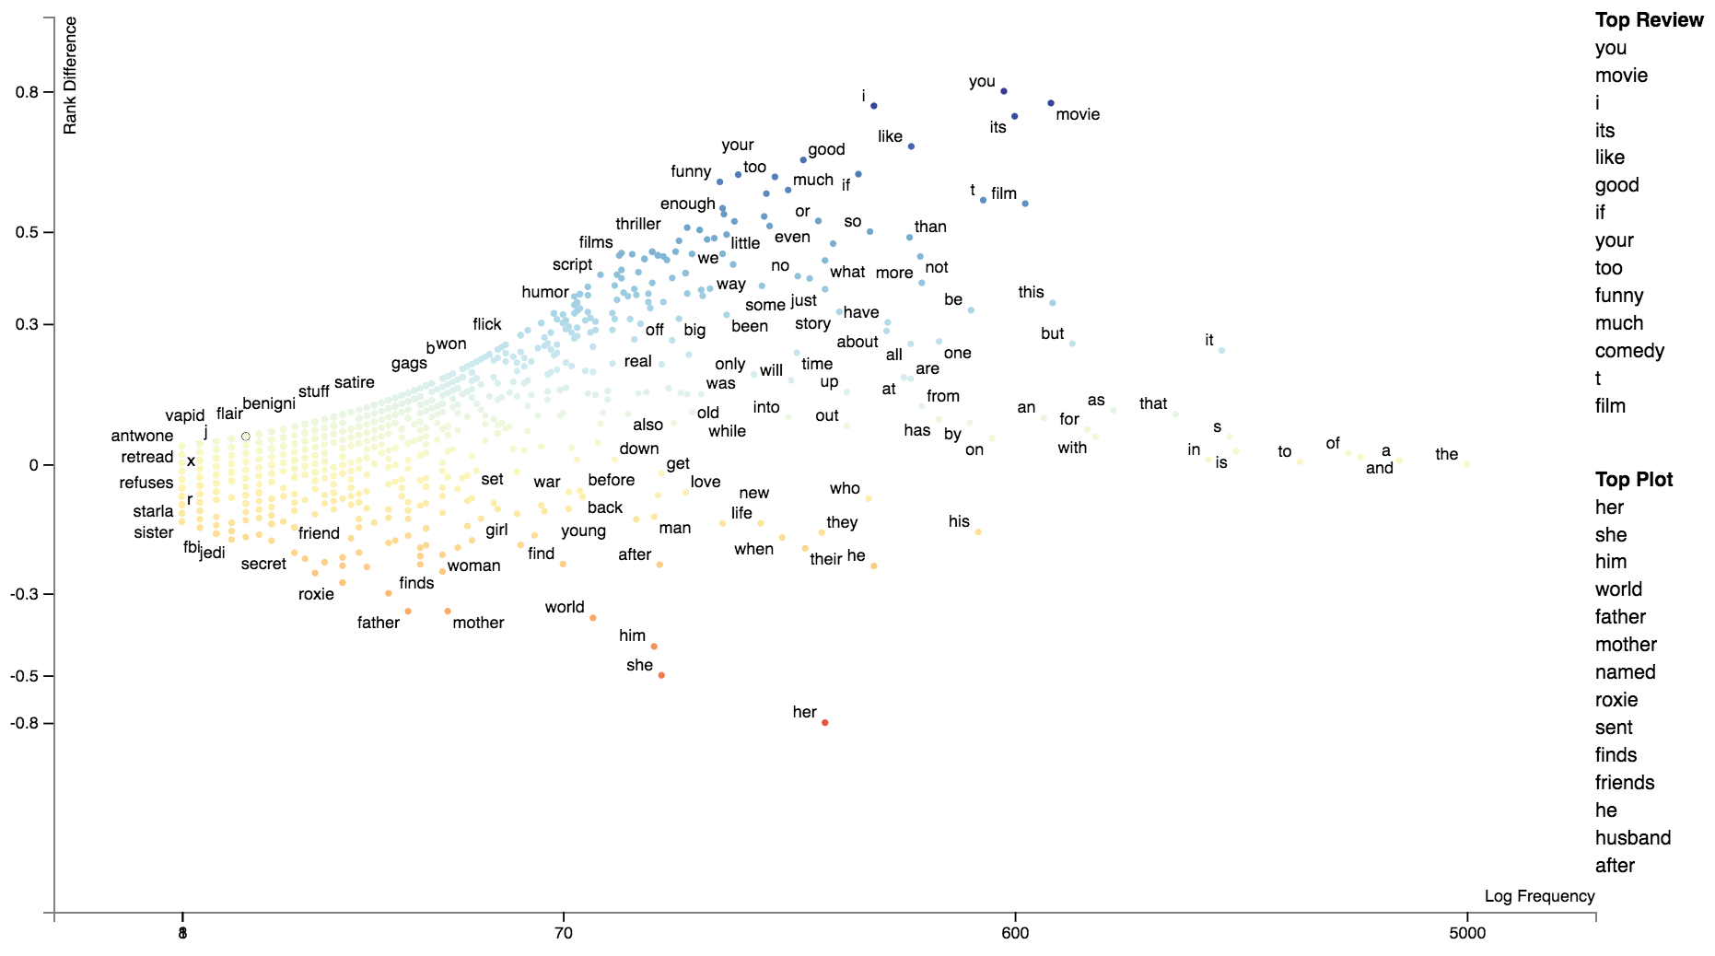
REVIEW
PLOT
@jasonkessler

Slide 30
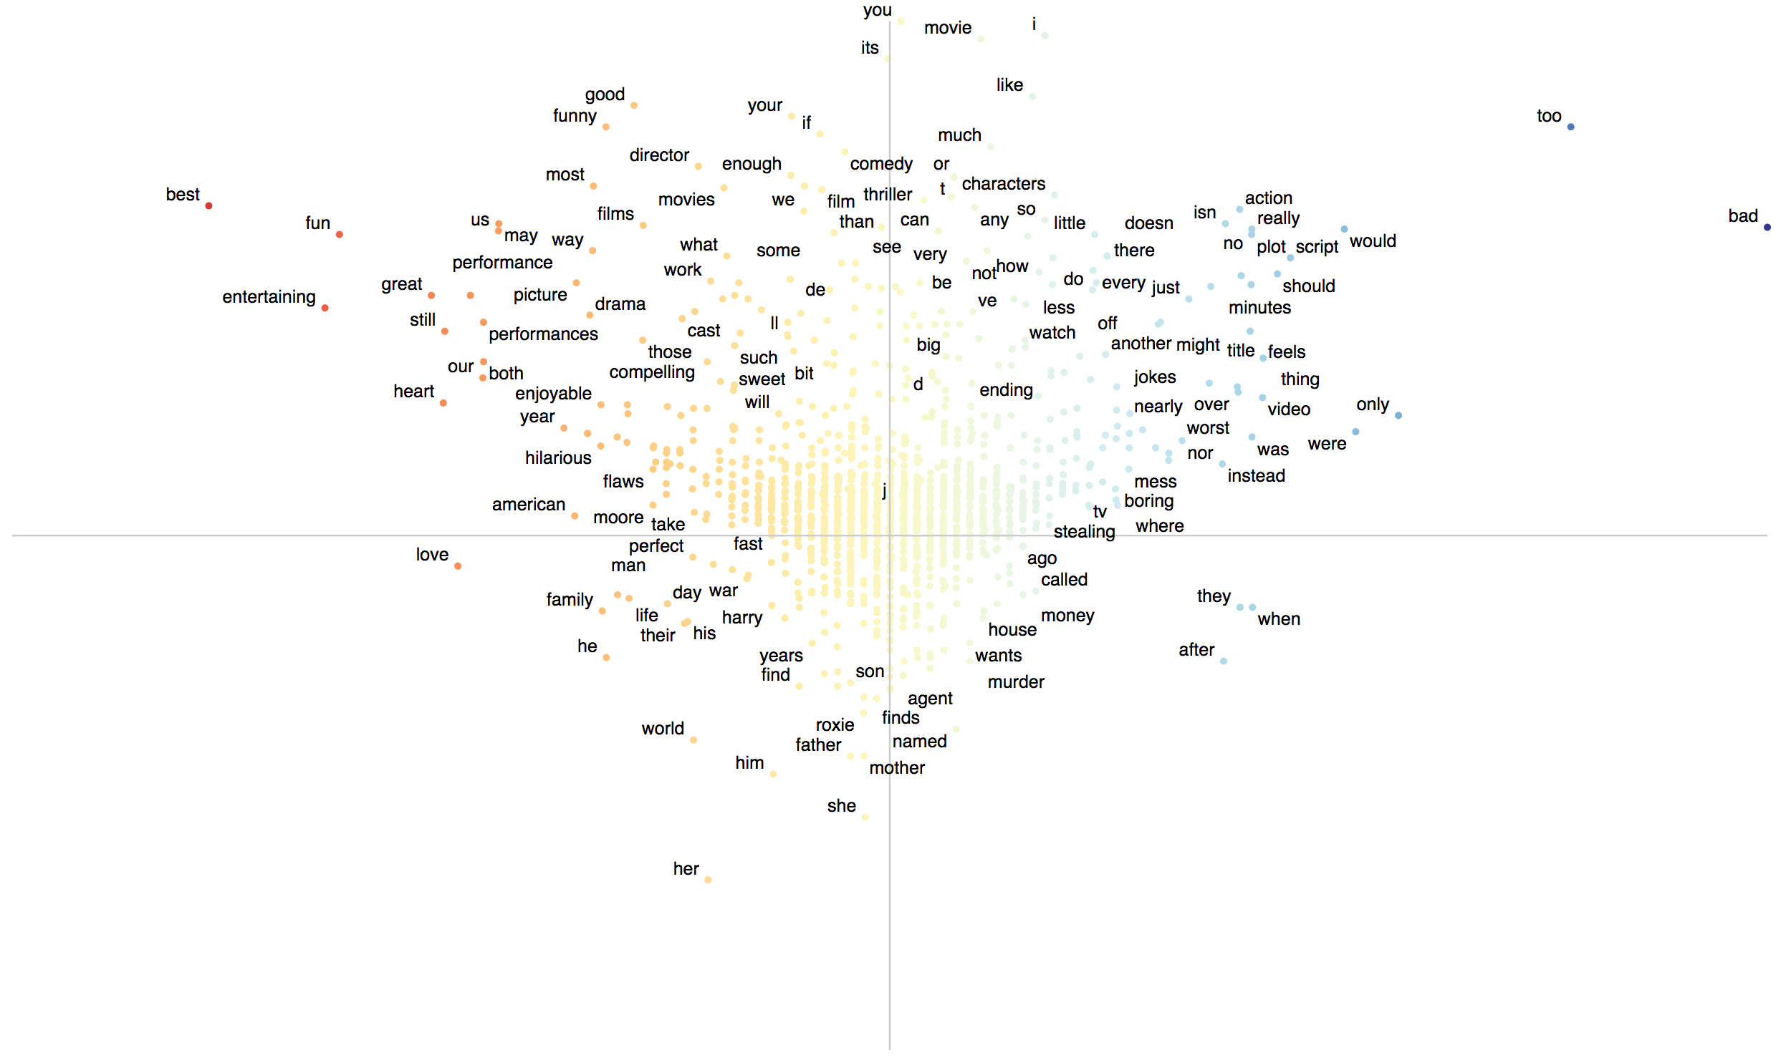
REVIEW
POSITIVE
NEGATIVE
PLOT
@jasonkessler

Slide 31
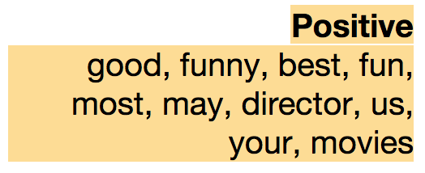
REVIEW
Positive corner of semiotic square:
Terms near (Euclidean distance) of blue point
Limit to Quadrant II
Captures positive terms used disproportionately in reviews
POSITIVE
NEGATIVE
PLOT
@jasonkessler

Slide 32
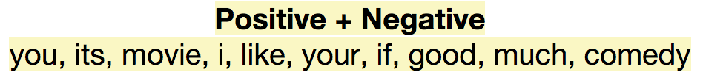
REVIEW
POSITIVE
NEGATIVE
Positive + Negative complex term:
Terms near (Euclidean distance) of blue point
Limit to Quadrant II and Quadrant I
Captures terms which are associated with reviews but not highly polar.
PLOT
@jasonkessler

Slide 33
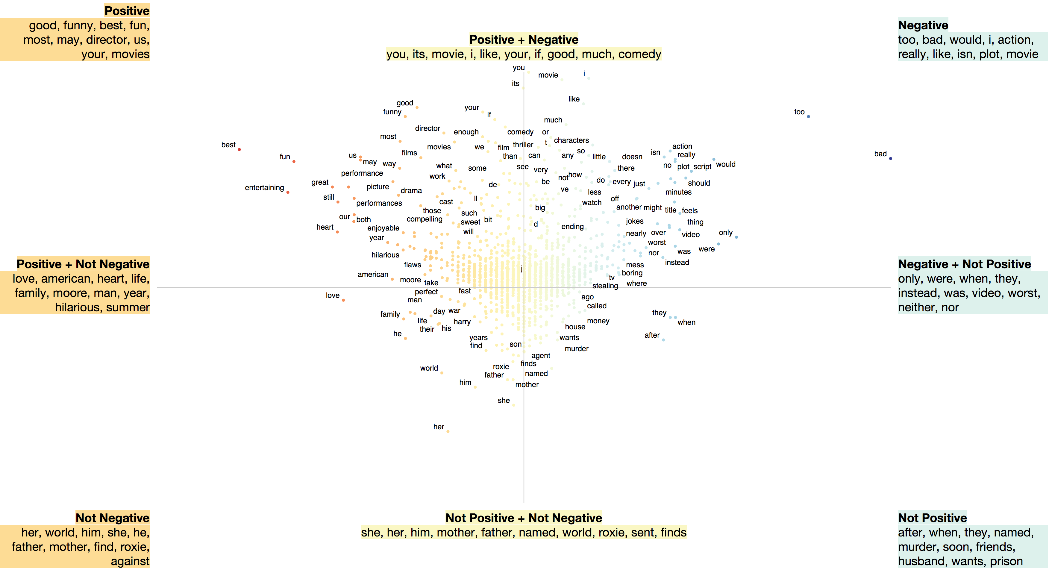
@jasonkessler

Slide 34
"The square is a map of logical possibilities. As such, it can be used as a heuristic device, and in fact, attempting to fill it in stimulates the imagination… the theory of the square allows us to see all thinking as a game, with the logical relations as the rules and concepts current in a given language and culture as the pieces."
Lithuanian stamp issued honoring the 100th birthday of Greimas.
Lithuanian stamp issued honoring the 100th birthday of Greimas.
@jasonkessler

Slide 35
Thank you
@jasonkessler

Slide 36
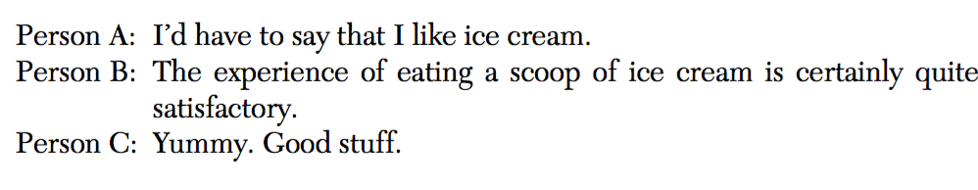
In defense of stop words
Function words reveal traits psychological traits. Person A is tentative, B is stiff, C is easy going.
Cindy K. Chung and James W. Pennebaker. The Psychological Functions of Function Words. Social Communication. 2007.
@jasonkessler

Slide 37
James Clifford. The Predicament of Culture. The Predicament of Culture: Twentieth-Century Ethnography, Literature, and Art. Harvard Univ. Press. 1988.
@jasonkessler

Slide 38
Lexicalizing the Semiotic Square
Language about movies
Evaluative
Positive
Negative
Aspects of well-reviewed movies
Aspects of poorly-reviewed movies
¬Negative
¬Positive
Objective
@jasonkessler

Slide 39
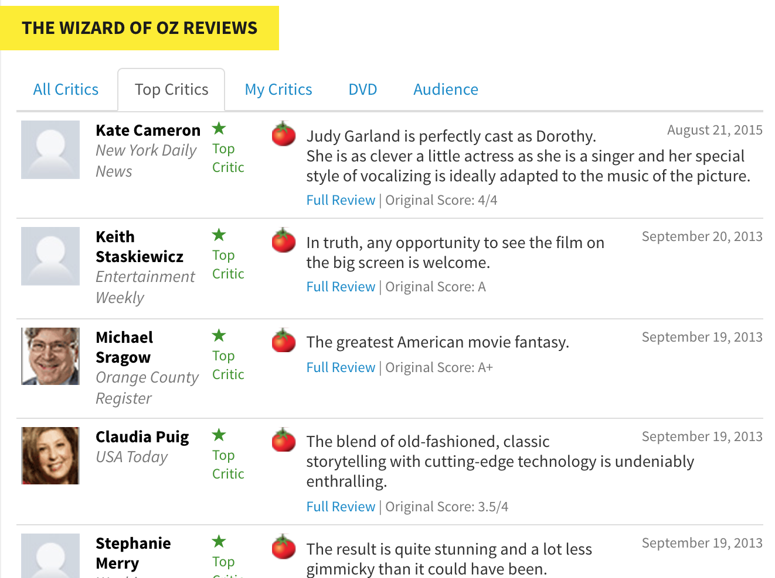
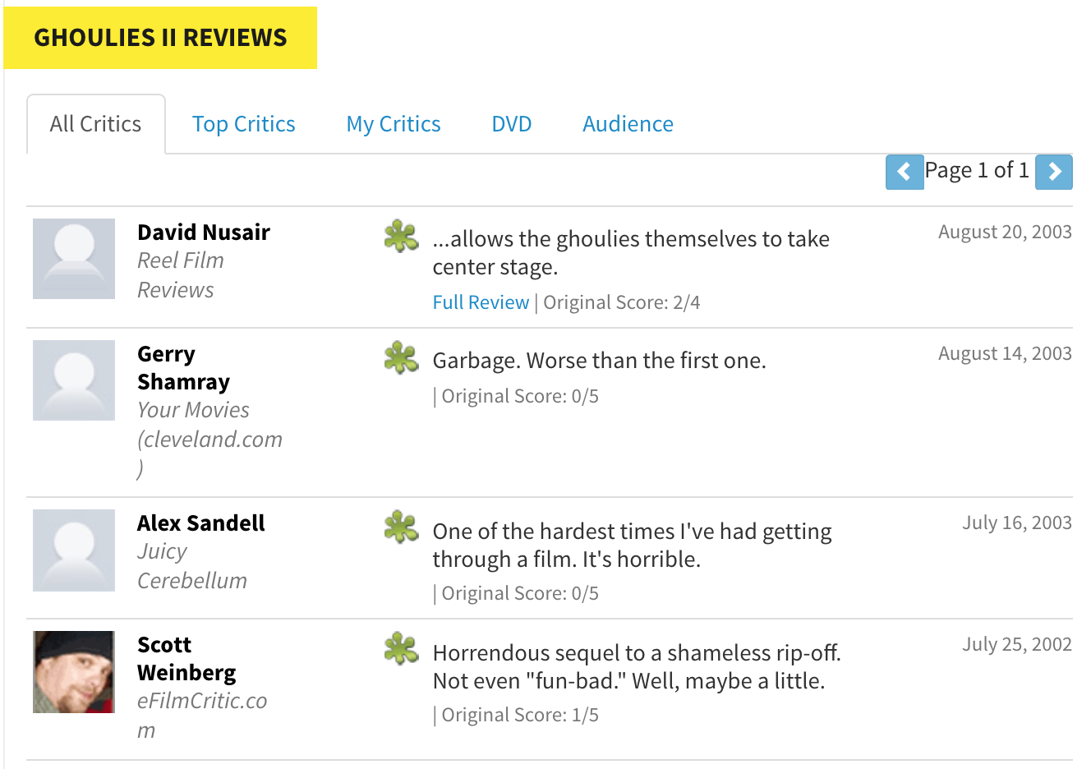

Slide 40
Lexicalizing the Semiotic Square
Positive Documents
Negative Documents
Complex term
Pos
Neg
E.g., negative reviews
E.g., positive reviews
Positive Deixis
Negative Deixis
¬Neg
¬Pos
Neutral Term
Lexicons: compare positive and negative corpora
@jasonkessler

Slide 41
Vitaliy Kaurov. Finding X in Espresso: Adventures in Computational Lexicology. Wolfram Blog. 2017.
@jasonkessler

Slide 42
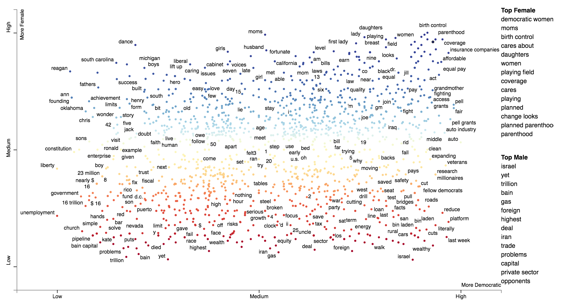
Jason Kessler. Using Scattertext and the Python NLP Ecosystem for Text Visualization. PyData. July. 2017
@jasonkessler

Slide 43
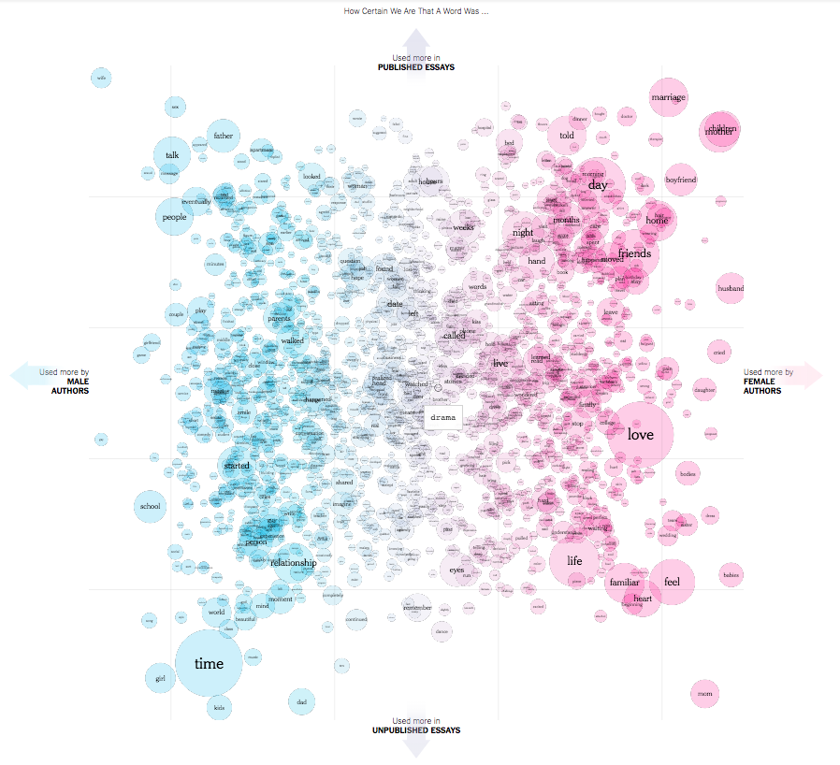
Josh Katz, Claire Cain Miller And Kathleen A. Flynn. The Words Men and Women Use When They Write About Love. The Upshot. The New York Times. Nov 2017.
@jasonkessler

